Slide 1
Vite Engineering Practice
Vite: Next Generation Frontend Tooling
Presentation by 朱迎春 Season Zhu
2021.10.27

Slide 2
Table of Content
简介 Introduce
Introduce myself and Vite
Vite 原理 Vite Principle
How Vite works
工程化实践 Engineering Practice
Vite Engineering Practice
比较 Compare
Compared with Webpack
总结 Summary
Summary of this sharing

Slide 3
简介 Introduce
Introduce myself and Vite

Slide 4
简介 Introduce
介绍我自己
我叫朱迎春，英文名 Season，是来自 Technology & Mobile-Mobile-Mobile Development (China Team) 的一名前端开发。
钉钉：朱迎春 Season
E-Mail：zhuyingchun@tngdigital.com.my
My name is Zhu Yingchun, English name Season, a front-end developer from Technology & Mobile-mobile-Mobile Development (China Team).
Ding Talk: 朱迎春 Season
E-Mail: zhuyingchun@tngdigital.com.my
Vite 简介
Vite 是 Vue 的作者尤雨溪开发的一个前端开发构建工具，开发过程中它利用浏览器 Native ES Module 特性按需导入源码，预打包依赖。是为开发者量身定做的一套先进的开发工具，默认整合 Vue3。
本次分享将由我和 Jerry 跟大家一起探讨 Vite 在前端工程化方面的实践，欢迎大家批评指正。
Vite is a front-end development and construction tool developed by the author of Vue Evan You. During the development process, it uses the browser native ES Module features to import source code on demand and pre-package dependencies. Is a set of advanced development tools tailor-made for developers, integrated with VUE3 by default. This sharing will discuss the practice of Vite in front-end engineering, welcome your comments.
In this sharing, Jerry and Me will discuss Vite's practice in front-end engineering with you. Your comments are welcome.

Slide 5

简介 Introduce
Vite（法语意为 "快速的"，发音 /vit/，发音同 "veet"）是一种新型前端构建工具，能够显著提升前端开发体验。它主要由两部分组成：
一个开发服务器，它基于 原生 ES 模块 提供了 丰富的内建功能，如速度快到惊人的 模块热更新（HMR）。
一套构建指令，它使用 Rollup 打包你的代码，并且它是预配置的，可输出用于生产环境的高度优化过的静态资源。
Vite 意在提供开箱即用的配置，同时它的 插件 API 和 JavaScript API 带来了高度的可扩展性，并有完整的类型支持。
Vite (French word for "quick", pronounced /vit/, like "veet") is a build tool that aims to provide a faster and leaner development experience for modern web projects. It consists of two major parts:
A dev server that provides rich feature enhancements over native ES modules, for example extremely fast Hot Module Replacement (HMR).
A build command that bundles your code with Rollup, pre-configured to output highly optimized static assets for production.
Vite is opinionated and comes with sensible defaults out of the box, but is also highly extensible via its Plugin API and JavaScript API with full typing support.

Slide 6
Vite 原理 Vite Principle
How Vite works

Slide 7
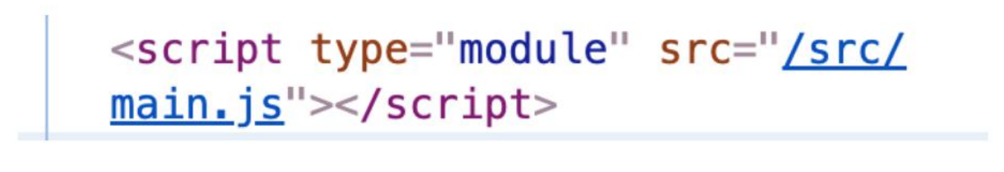
Vite 原理 Vite Principle
Vite 原理
在 index.html 中，浏览器利用 ES Module imports（注意：需要高版本浏览器的支持）
In index.html, browsers utilize ES Module imports (note: older browser support is required)

Slide 8
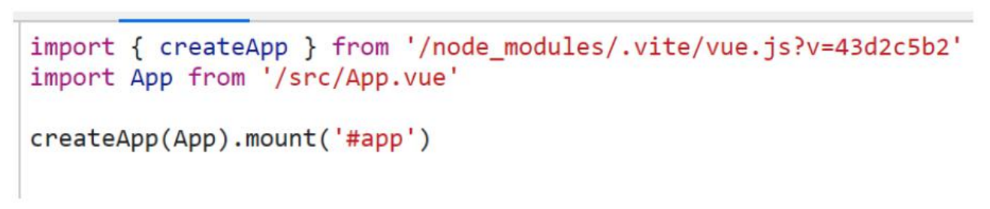
Vite 原理 Vite Principle
预编译，第三方依赖预打包。
Precompiled, third parties rely on prepackaged.

Slide 9
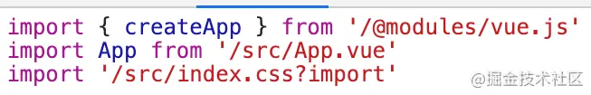
Vite 原理 Vite Principle
分模块解析。
Module parsing.

Slide 10
Vite 原理 Vite Principle
为什么快如闪电？
<script type="module" src="/src/main.js"></script> 浏览器直接引用 ES Module 不需要打包了
按需加载，本地包预编译
Why is it lightning fast?
<script type="module" src="/src/main.js"></script> Browsers that reference ES Modules directly do not need to be packaged
Load on demand, local package precompilation

Slide 11
工程化实践 Engineering Practice
Vite Engineering Practice

Slide 12
工程化实践 Engineering Practice
兼容性注意
Vite 需要 Node.js 版本 >= 12.0.0。
默认的构建目标浏览器是能 在 script 标签上支持原生 ESM 和 原生 ESM 动态导入。传统浏览器可以通过官方插件 @vitejs/plugin-legacy 支持 —— 查看 构建生产版本 章节获取更多细节。
Compatibility Note
Vite requires Node.js version >=12.0.0.
The default build targets browsers that support both native ESM via script tags and native ESM dynamic import. Legacy browsers can be supported via the official @vitejs/plugin-legacy - see the Building for Production section for more details.

Slide 13
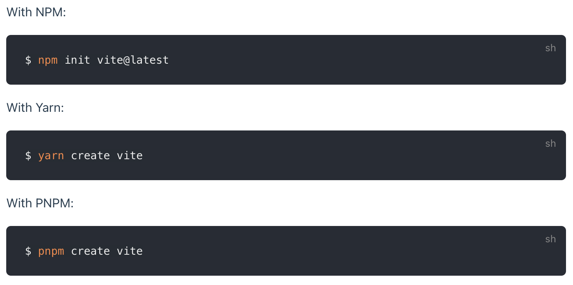
工程化实践 Engineering Practice
安装 Install

Slide 14
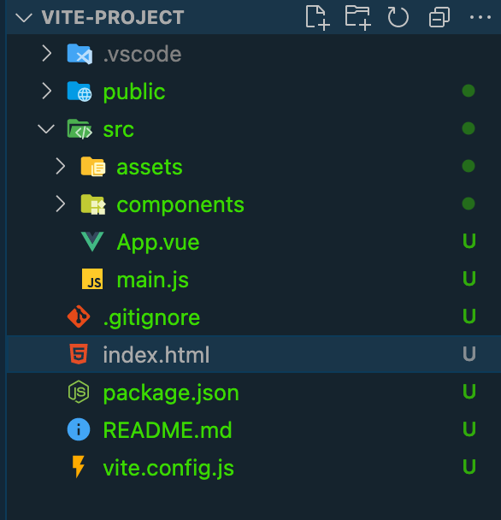
工程化实践 Engineering Practice
目录结构 Directory Structure
别名配置 The alias configuration
资源加载 Resource to load
CSS
Image
TS 默认支持 TS Default support
数据模拟 Data Mock
服务器代理配置 Server proxy Configuration
代码规范 ESLint + Prettier ESLint + Prettier
单元测试 Unit Test
自定义插件开发 Custom Building Plugin

Slide 15
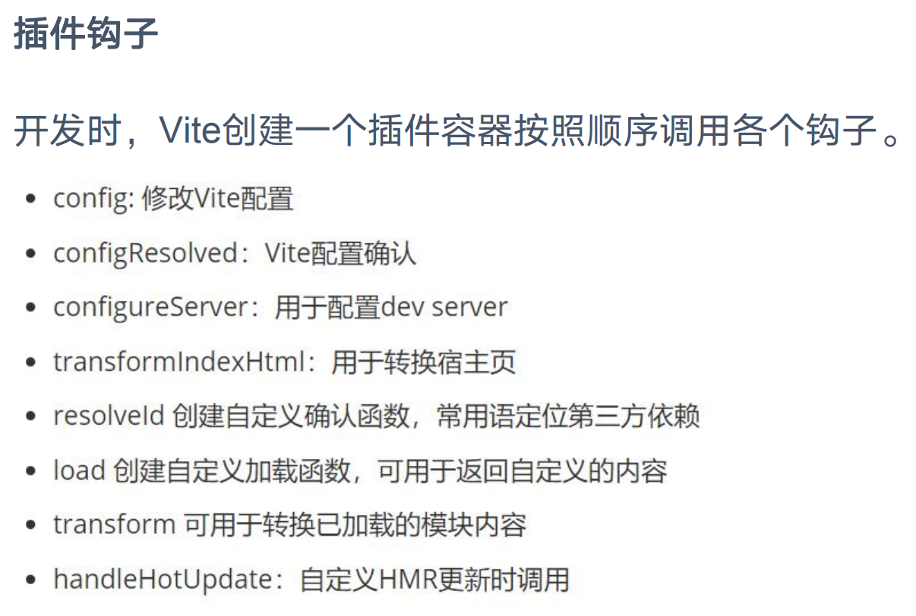
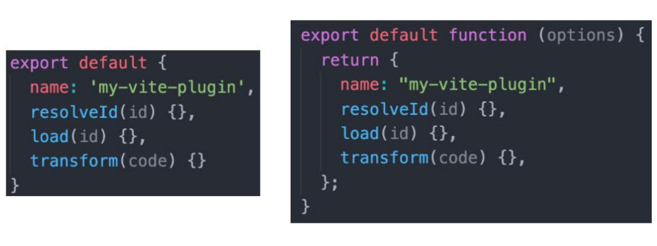
工程化实践 Engineering Practice
插件开发 Building Plugins（进阶技能 Advanced skills ）

Slide 16
比较 Compare
Compared with Webpack

Slide 17
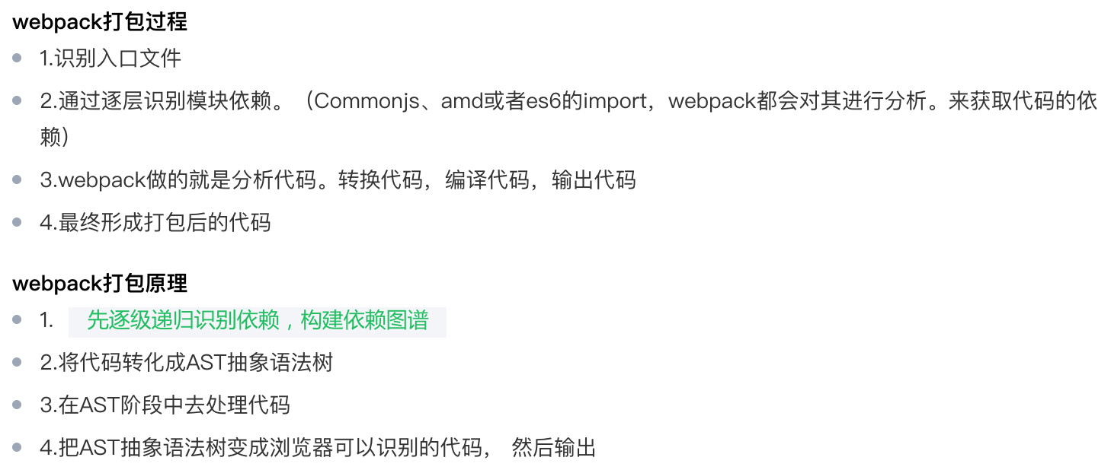
比较 Compare
Vite VS Webpack

Slide 18
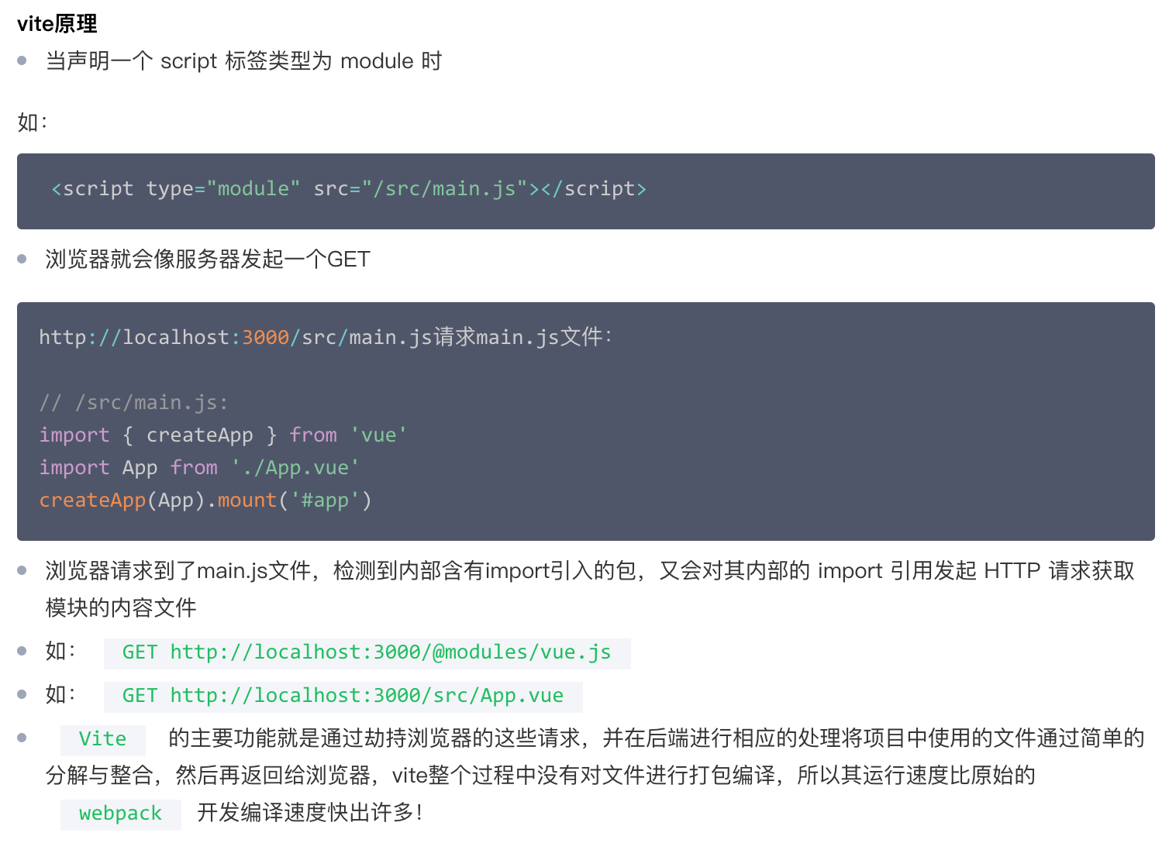
比较 Compare

Slide 19
比较 Compare
优点：
针对 Webpack 的痛点改进，如：服务器启动慢、打包慢、HMR 慢
按需加载，ES Build 本地包预编译
速度快到惊人的 模块热更新（HMR）
Advantages:
Improve the pain points of Webpack, such as slow server startup, slow packaging, slow HMR
Load on demand, ES Build local package precompiled
Surprisingly fast module hot Update (HMR)
缺点：
刚发布不久生态不如 Webpack，还需要进一步验证
Disadvantages:
The ecosystem is not as good as Webpack when it was just released and needs further validation

Slide 20
总结 Summary
Summary of this sharing

Slide 21
总结 Summary
简单介绍了什么是 Vite?
分析了 Vite 的工作原理
搭建了一个简易的脚手架
与其他打包工具如 Webpack 进行比较
What is Vite?
The working principle of Vite is analyzed
A simple scaffold was set up
Compare with other packaging tools such as Webpack

Slide 22
总结 Summary
Reference:
Vite Site
Vite 和 Webpack 的核心差异

Slide 23
F A Q

Slide 24
Thank you

